Slide 1



Riders Data Analysis
A comprehensive data-driven study analyzing ride performance, service efficiency, and customer trends using SQL and Power BI.
This project identifies key revenue patterns, cancellation behavior, and operational insights to help optimize business decisions.

Slide 2

Overview
The rapido riders data analysis project focus on understanding the overall ride performance, service revenue through data analytics. Using structured SQL queries, business insights were extracted to reveal peak hours, service performance, and operational bottlenecks. Power Bi dashboards were then created to transform raw data into actionable visuals that aid strategic decision-making.
Tools Used:
SQL: Database creation, cleaning, and transformations.
Power BI: Dashboard design and interactive visualization.
Excel/CSV: Data export from SQL for Power BI connection.
DAX & Measures: For advanced calculations and dynamic
filtering.

Slide 3
Data Preparation Workflow
Database Creation
Table creation & Data Import
Data Cleaning
Store Procedure
Feature Engineering
EDA
Export to Power BI
Data Transformation
Dashboard & Insights

Slide 4

Business Problems Analyzed
Top 10 Business Questions:
  What are the total rides & total revenue generated?
  What is the ratio of completed vs cancelled rides?
  Which services contribute most to revenue?
  What is the average fare per kilometer by service type?
  What are the peak ride hours during the day?
  Which days of the week are the busiest?
  How much revenue is lost due to cancellations?
  What are the top payment methods among riders?
  Which are the most frequent source-destination routes?
  What is the average ride duration and distance by service?

Slide 5

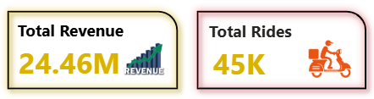
Q1 — Total Rides & Total Revenue
Problem:
Find the overall number of rides and total revenue to measure Rapido’s performance.
Completed over 45K rides generating around 24.4 M in total revenue.

Slide 6

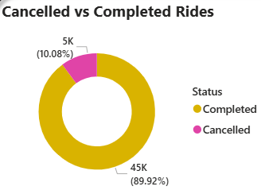
Q2 — Cancelled vs Completed Rides
Problem:
Identify how many rides are cancelled vs completed.
About 88% of rides were successfully completed, while 12% were cancelled, indicating strong service reliability.

Slide 7
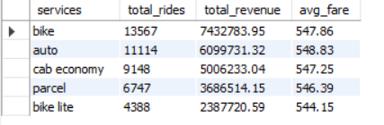
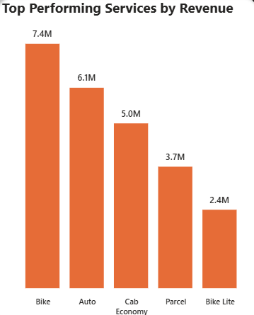
Q3 — Top Performing Services by Revenue
Rapido Bike service dominates with the highest number of rides and revenue share among all services.
Problem:
Which service (Bike, Auto, etc.) brings maximum revenue?

Slide 8
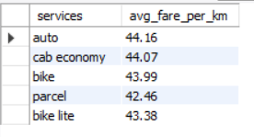
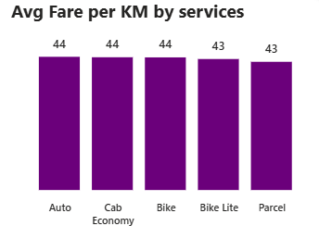
Q4 — Average Fare per KM by Service
Problem:
Find average fare efficiency per km across service types.
Average fare per km is around ₹44, with Auto rides showing slightly higher fare variation across routes.

Slide 9
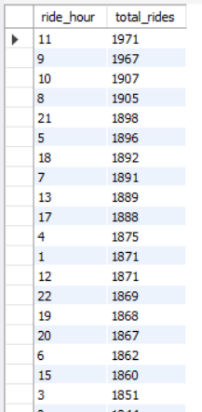
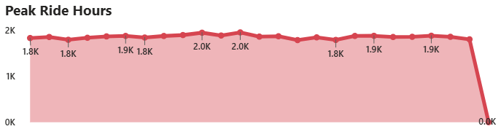
Q5 — Peak Ride Hours
Problem:
Determine when most rides occur.
Ride demand peaks during 8–10 AM and 6–8 PM, aligning with daily office commute hours.

Slide 10
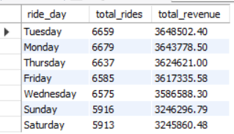
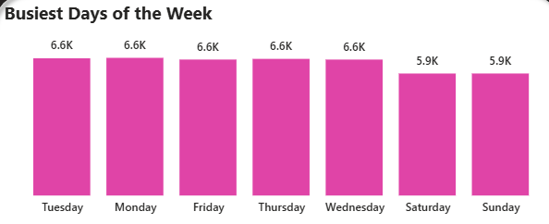
Q6 — Busiest Days of the Week
Problem:
Which days generate maximum rides and revenue?
Tuesday and Monday record the most rides, showing increased weekend mobility patterns.

Slide 11

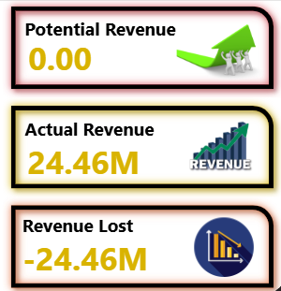
Q7 — Revenue Lost Due to Cancellations
Problem:
Estimate revenue lost from cancelled rides.
Estimated 24.4 lakh revenue lost due to ride cancellations — improving cancellation handling could recover major revenue.

Slide 12
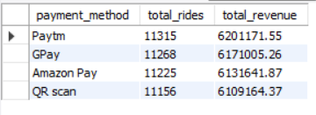
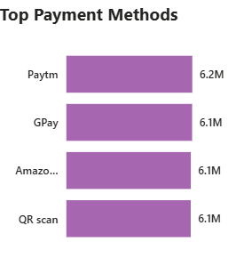
Q8 — Top Payment Methods
UPI is the most preferred payment mode, followed by Cash, indicating a digital-first customer base.
Problem:
Identify most preferred payment modes.

Slide 13
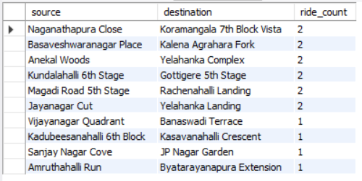
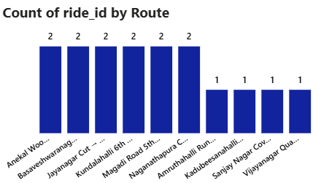
Q9 — Most Common Routes
Top routes include Koramangala, MG Road and BTM showing major commuter corridors.
Problem:
Find top 10 frequently travelled routes.

Slide 14
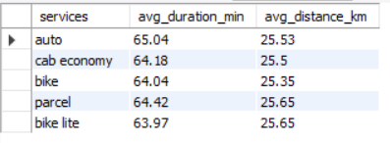
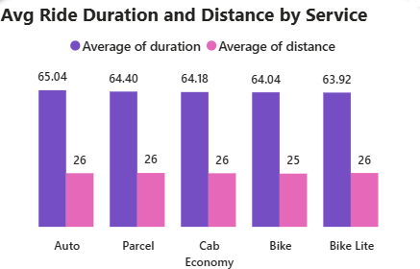
Q10 — Avg Duration & Distance by Service
Problem:
Analyze how service types differ in time and distance per ride.
Average ride duration is 63 minutes covering 25 km, with longer rides mostly from outer city zones.

Slide 15

Key Business Recommendations
Optimize driver allocation during high-demand hours to reduce waiting time and increase ride completion rates.
Introduce performance-based incentives for drivers and customers to encourage timely rides and higher satisfaction.
Enhance digital payment adoption through cashback or discount campaigns to improve transaction efficiency and transparency.
Leverage route analytics to strengthen marketing and operational focus on high-performing corridors.
Refine fare strategies using per-kilometer and time-based insights to maintain competitive yet profitable pricing.

Slide 16

Strategic Takeaways
The analysis uncovered key demand trends, revenue drivers, and operational inefficiencies.
Data-driven insights enable better decision-making across pricing, operations, and customer engagement.
SQL queries simplified the process of cleaning and extracting actionable business data.
Power BI visualizations transformed complex metrics into clear, impactful dashboards.
The project demonstrates how data analytics can directly enhance Rapido’s efficiency, profitability, and customer experience.

Slide 17

Thank you…

